Slide 1
Final Project
Location analysis tool using data from Foursquare
Participante: Anthony Alarcón

Slide 2
INDEX
Introduction
Business Problem
Data acquisition
Methodology
Results
Conclusion

Slide 3
INTRODUCTION
1

Slide 4

INTRODUCTION
The success of a business depends a lot on its location. The street, the orientation and the views are fundamental. But so is the economic activity that is in the vicinity.
A very important decision, after having chosen the product you will sell, is the geographical place where you will offer it.

Slide 5
BUSINESS PROBLEM
2

Slide 6

BUSINESS PROBLEM
Goal
Is there a tool or solution that helps entrepreneurs define the location of their business?
For this case, we will focus on a group of entrepreneurs who decide to open a pastry shop in Santiago de Surco - Lima, Peru.

Slide 7
DATA ACQUISITION
3

Slide 8
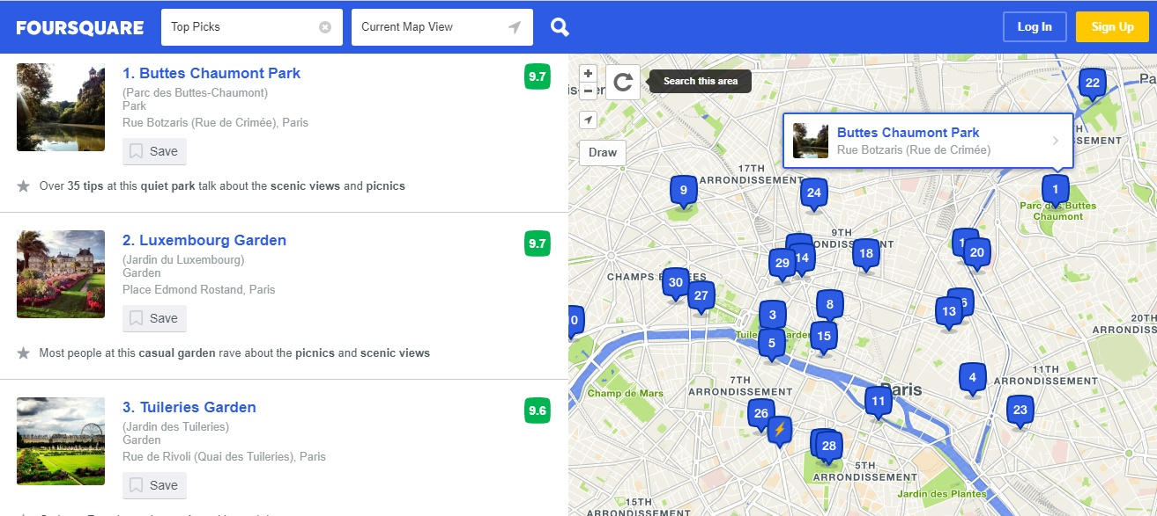
DATA ACQUISITION
Some information
Latitude
Longitude
Address
Categories
Country

Slide 9
METHODOLOGY
4

Slide 10


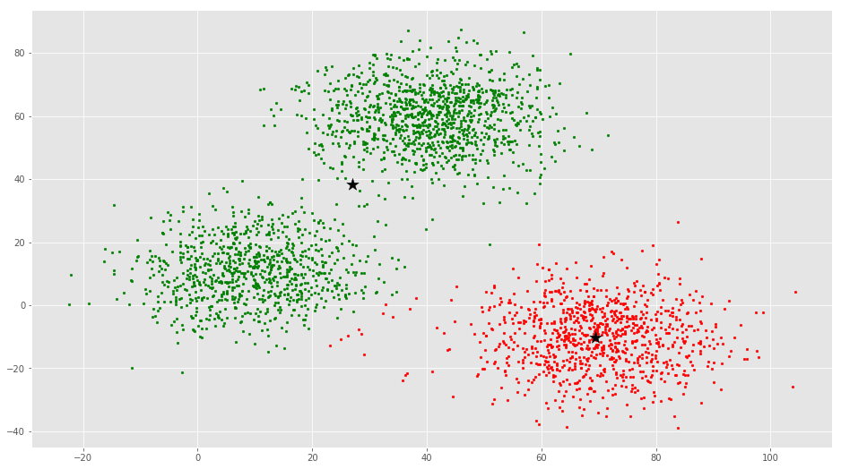
METHODOLOGY
Kmeans
Data
Script - Py
Data Location
Include: The connection was made with the Foursquare service.
Processing
Geolocation services were used to map the places with the highest concentration
Predicción final

Slide 11
RESULTS
5

Slide 12
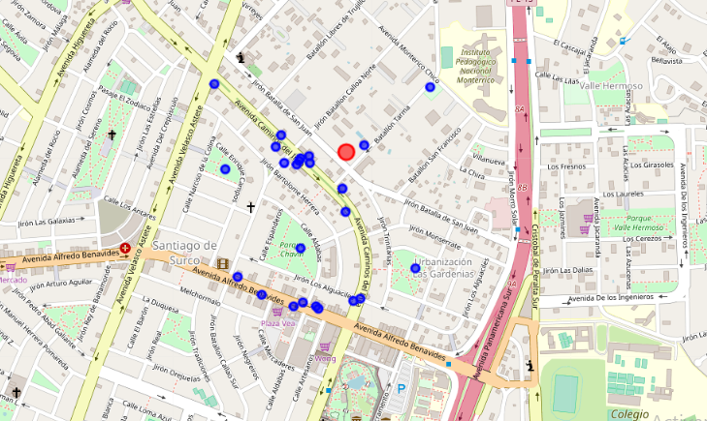
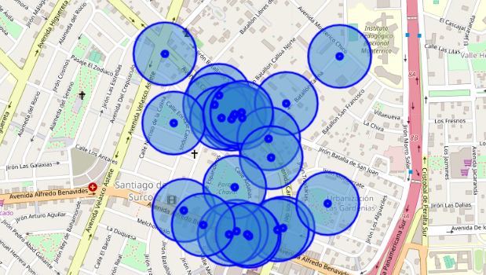
RESULTS
This is to seek the areas that have the highest concentration of people and that is as commercial as possible.
LOCATIONS

Slide 13
RESULTS
Name | Categories | Address | CC | City | Country | Distance | FormattedAddress | Lat | Lng
Dalcello | Ice Cream Shop | Caminos del Inca 1502 | PE | Surco | Perú | 152 | [Caminos del Inca 1502, Surco, Perú] | -12.12544 | -76.98328
Il Piccolo Pomodoro | Italian Restaurant | Av. Caminos del Inca 1473 | PE | Surco | Perú | 202 | [Av. Caminos del Inca 1473, Santiago de Surco, Perú] | -12.12464 | -76.98372
Tierra Santa | Middle Eastern Restaurant | Av. Caminos del Inca 1512 | PE | Surco | Perú | 142 | [Av. Caminos del Inca 1512, Santiago de Surco, 33, Perú] | -12.12533 | -76.98321
La Verdad de la Milanesa | Restaurant | Av. Caminos del Inca 1478 | PE | Surco | Perú | 212 | [Av. Caminos del Inca 1478, Surco, LIMA 33, Perú] | -12.12495 | -76.98386
Cluster Label | Name | Categories | Lat | Lng
2 | Dalcello | Ice Cream Shop | -12.125442 | -76.98328
2 | Il Piccolo Pomodoro | Italian Restaurant | -12.124636 | -76.98372
2 | Tierra Santa | Middle Eastern Restaurant | -12.125327 | -76.983209
2 | La Verdad de la Milanesa | Restaurant | -12.124947 | -76.983864

Slide 14
DISCUSION
6

Slide 15
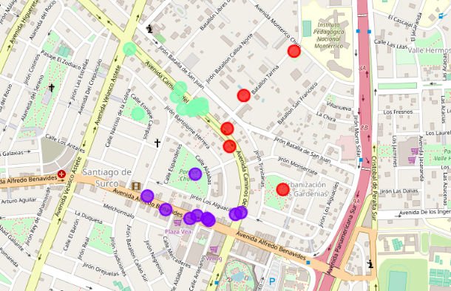
DISCUSION
Now with the results obtained, we can note that there are 3 large commercial balloons that make up a small part of Santiago de Surco. In this way, you can have a clearer idea of where to open the business. A very key option to open it at a point where it is adjacent to the groups or what is most acceptable by affinity to each group.

Slide 16
CONCLUSION
6

Slide 17
CONCLUSION
It can be concluded that advanced analytical tools are very enriching. Taking this case in specific, the location of a business is a key aspect that can define the success or failure of a business. That is why the constant alternatives that exist in the market to solve the problem. What has been exposed is one of the forms

Slide 18
THANKS

